Slide 1
GPU rats can do combat
Start work on POI Capture/Combat effects
GPU rats can generate corpses
Improve biome generation to have larger biomes
Improve POI generation to work in clusters
Improved GPU rat movement
Sped rats up by 3x
Hordes can now fully die if they aren't the last one left for a player
Lots of GPU rat bug fixing
Active mutations!
Combat options!
Testing swap with Seal Team 7
Enemy/friendly horde icons
Work on indicators for POI capture status
Work on making humans defend POIs

Slide 2
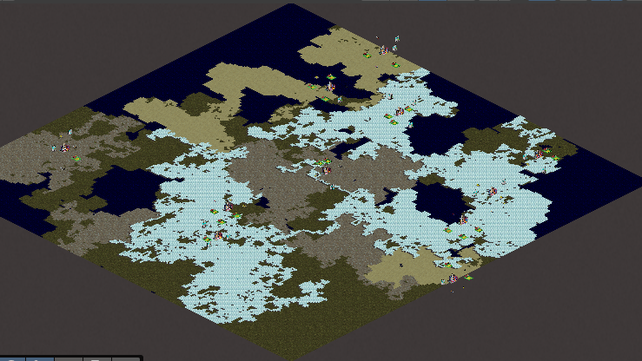
Updated Biomes

Slide 3
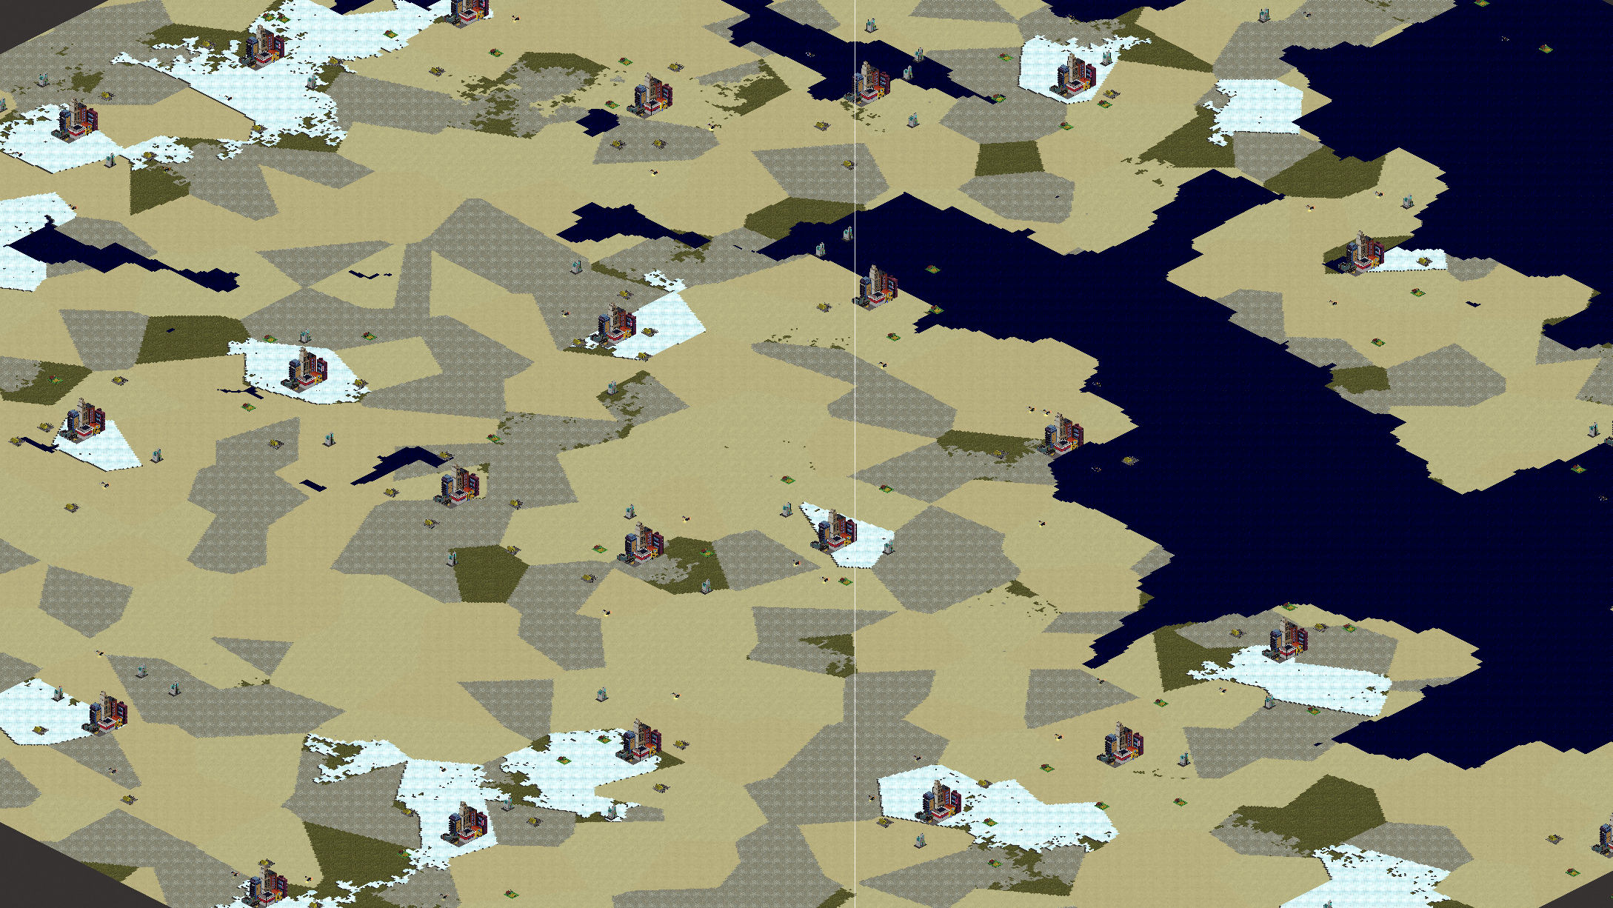
Updated POI Placement

Slide 4
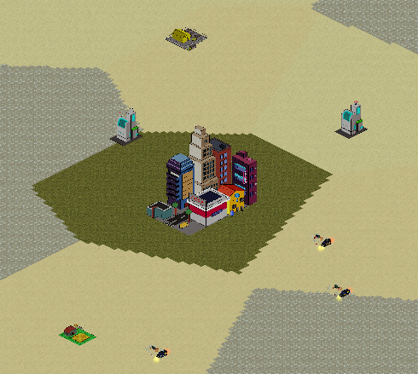
Updated POI Placement - Clustering

Slide 5
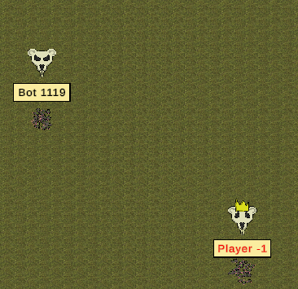
Horde Icons

Slide 6
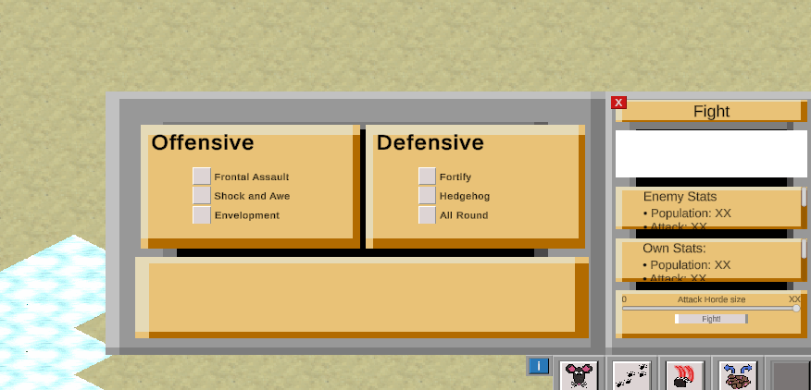
Combat Options

Slide 7
Testathon!
Testing with Seal Team 7 the day before, identified lots of bugs which we squashed before Testathon
People were curious about the game
Liked combat, controlling big hordes, and the multiplayer aspect
Main improvements wanted were UI/clarity of purpose
Someone had 60,000 rats and performance was still very acceptable! And 1.08 machines are better than 2.11 machines too.

Slide 8
PXI
Meaning - 3.1 / 5
Curiosity – 3.7 / 5
Mastery - 2.7 / 5
Autonomy – 3.4 /5
Immersion – 2.7 / 5
Progress Feedback – 2.7 / 5

Slide 9
Plans before Panel
Fix bugz
Add indicators to POIs
Add variation to rat sprites
Objectives list

